Slide 1
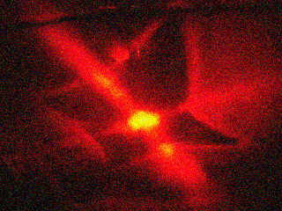
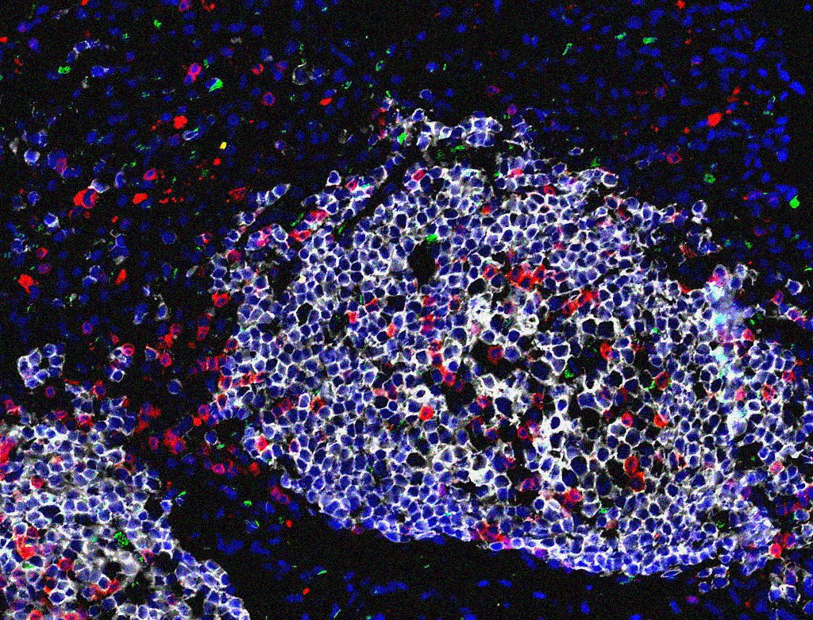
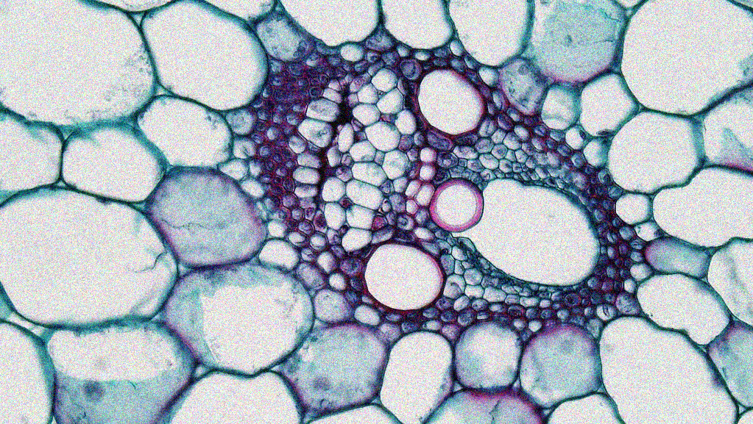
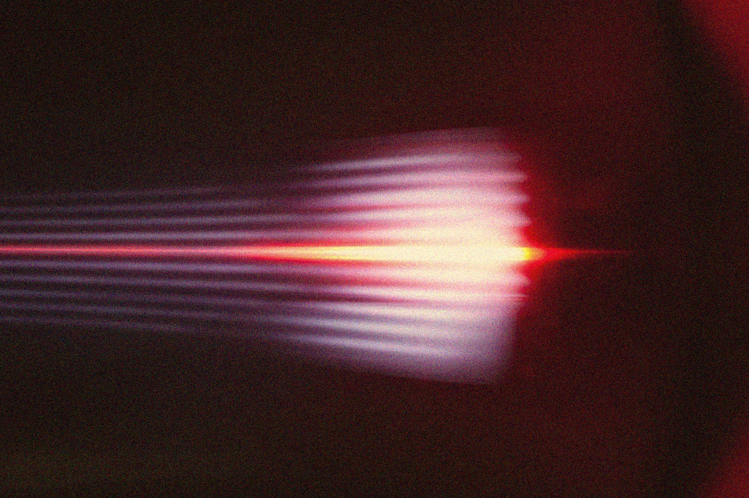
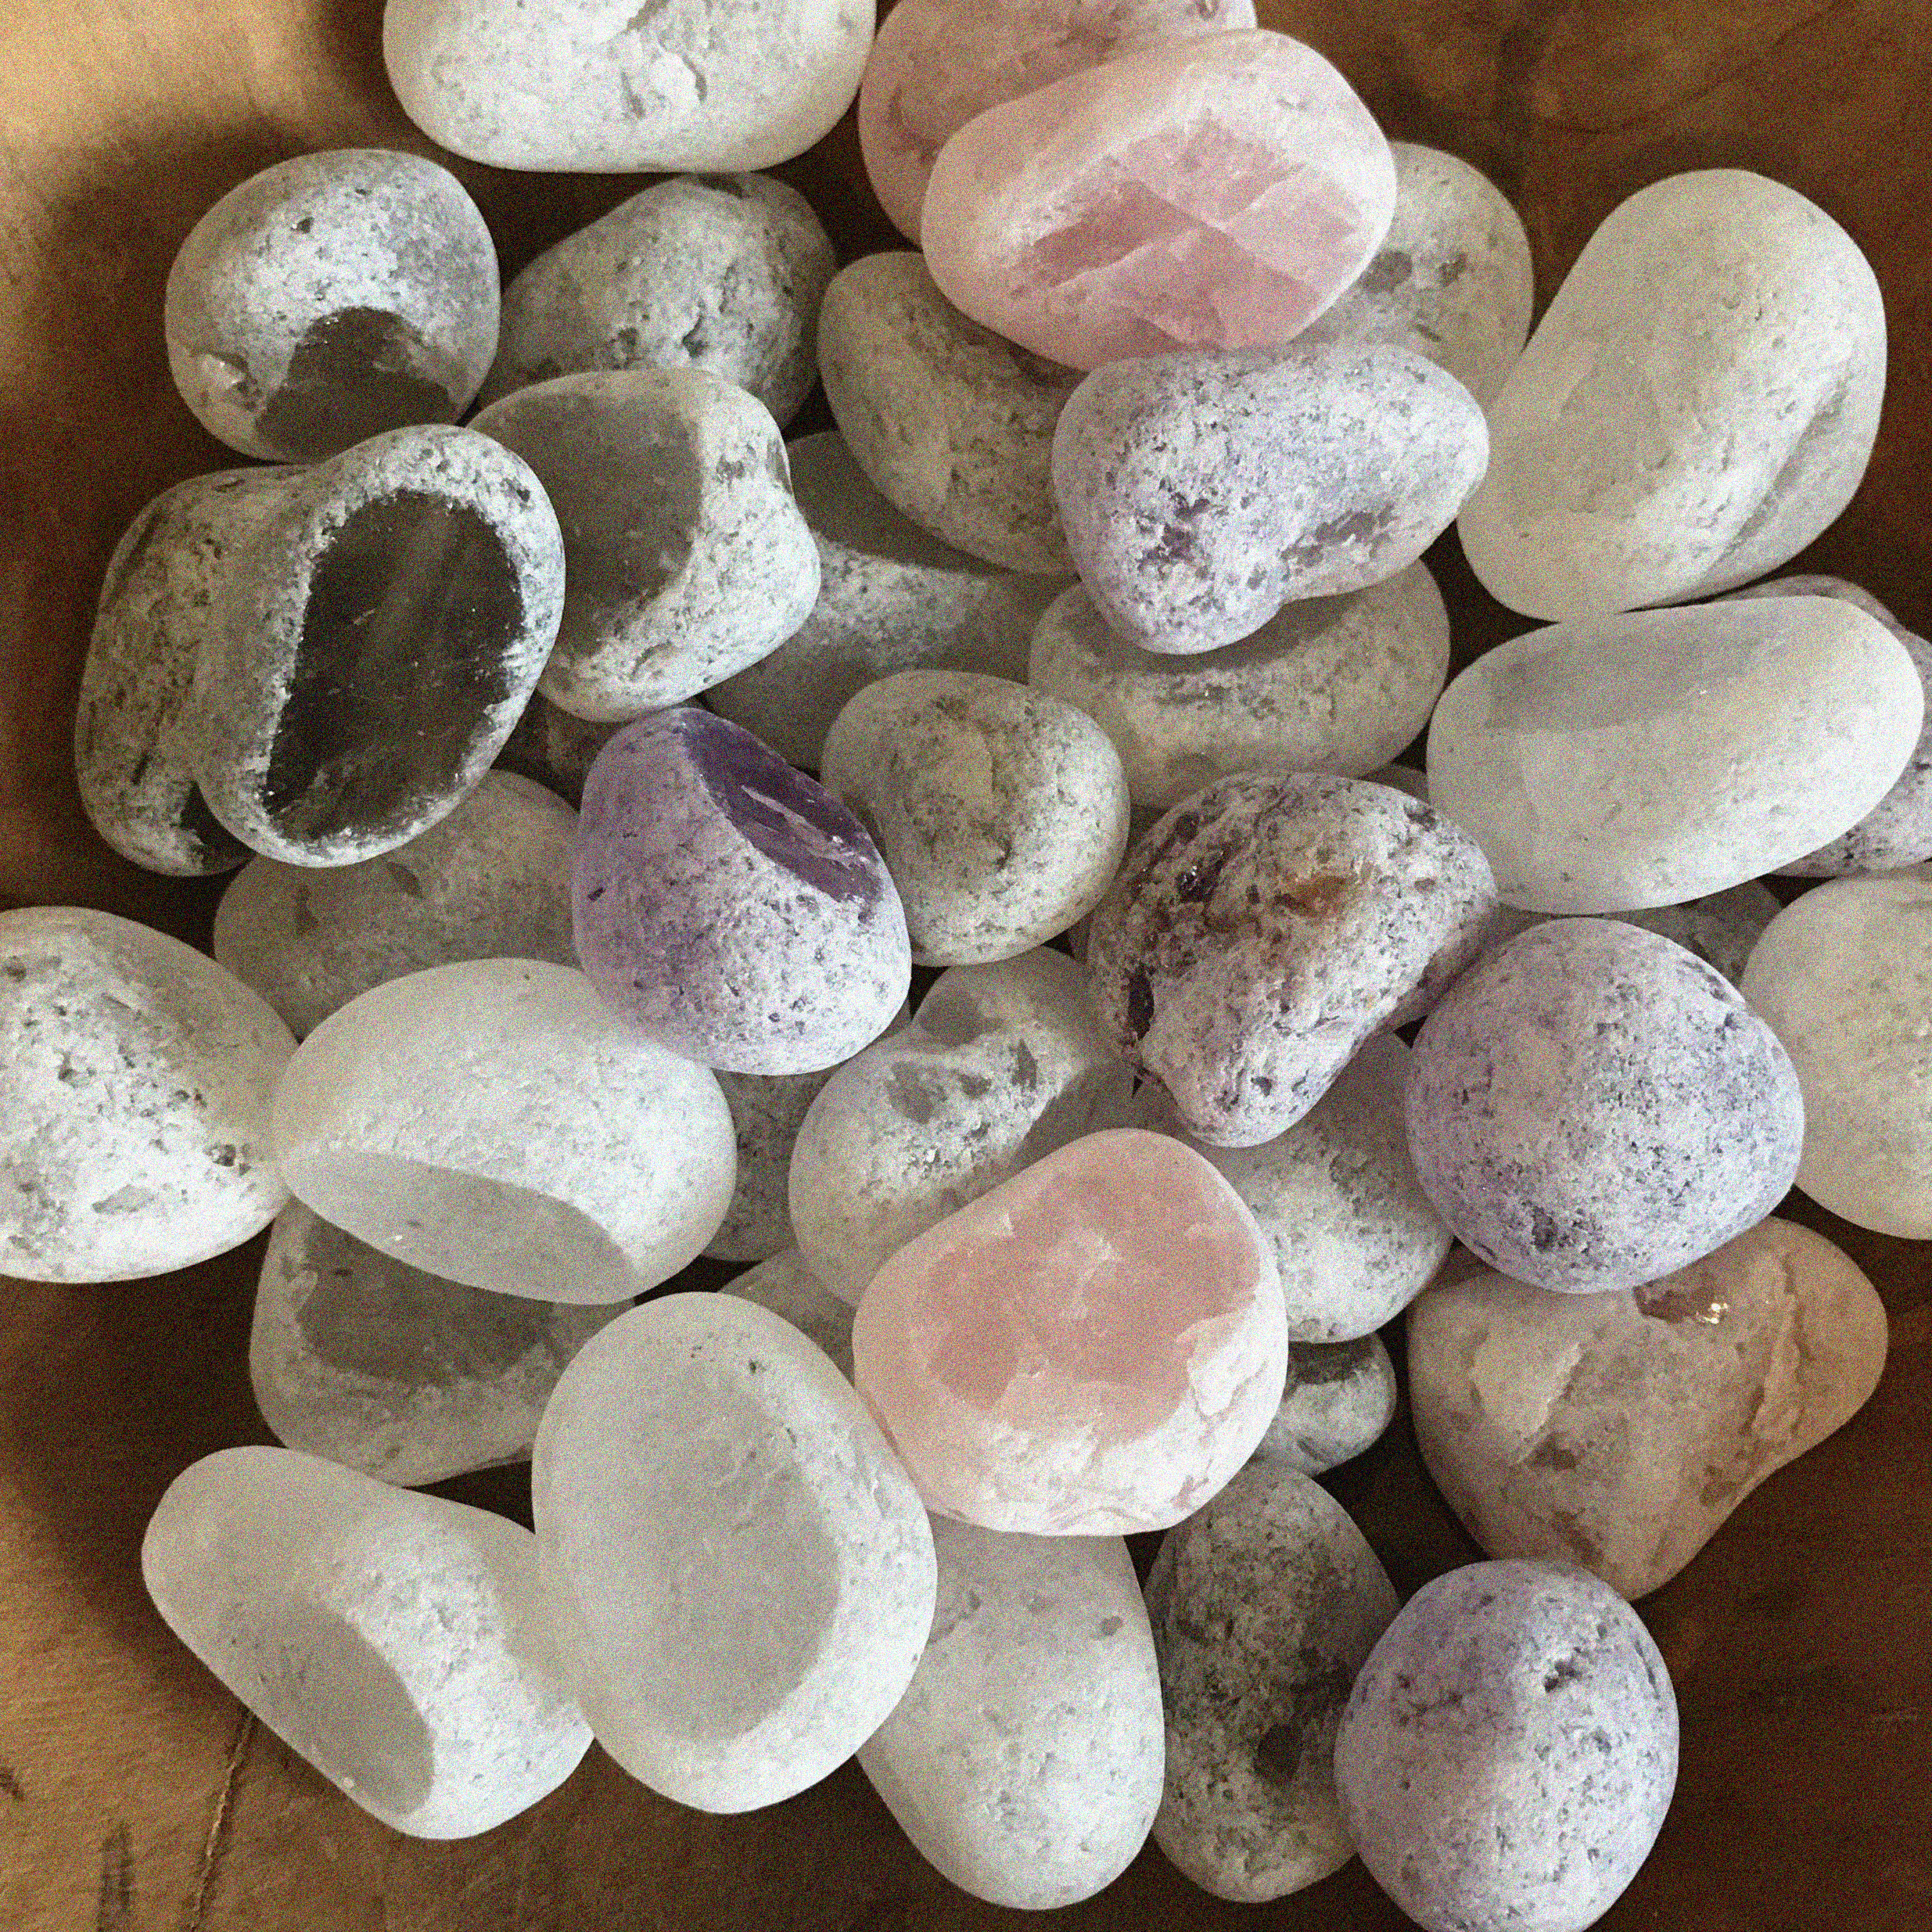

APP PHYSICS 157
COMPUTATIONAL ANALYSIS AND MODELLING
FEATURE EXTRACTION USING IMAGEJ
IMAGE AND VIDEO PROCESSING – MODULE 1
NINO PHILIP RAMONES | GITHUB
2020 – 05616
APRIL 21, 2023
This Photo by Unknown Author is licensed under CC BY-NC-ND
This Photo by Unknown Author is licensed under CC BY-SA-NC

Slide 2

APP PHYSICS 157
PROPERTIES AND APPLICATIONS OF THE 2D FFT
OBJECTIVES
Observe the rotation property of two-dimensional Fourier transform and examine how it comes into play in simulating patterns in images
Explore some of the different applications of Fourier transform in filtering frequencies in Fourier space
KEY TAKEAWAYS
Similar to the previous activity, setting your image resolution to any powers of two will greatly speed up the calculation process when subjected to FFT algorithms and filtering
Investigate the convolution theorem redux of some pair apertures
The FFT algorithm comes into play when filtering unwanted frequencies or signals, which is useful in altering the appearance of images
SOME PITFALLS
The pattern that must be convolved must be of the same size as it processes both images by checking and comparing it pixel by pixel
The choice of mask for filter affects the apperance of the resulting filtered image

Slide 3
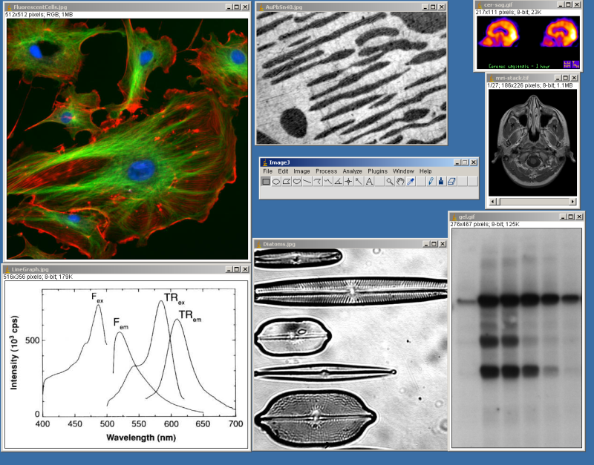
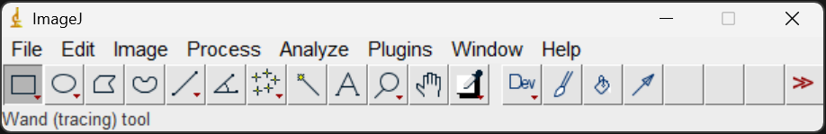
APP PHYSICS 157
FEATURE EXTRACTION USING IMAGEJ
IMAGEJ
Image Processing and Analysis in Java
ImageJ is a public domain image processing program developed at the National Institutes of Health for computational instrumentation. It is a Java-based scientific image processing software that can measure properties of objects using image segmentation techniques, which will be the focus of the next activities.
In this activity, ImageJ was used for image segmenting and analyze regions of interests as such. User-written plugins inherent to ImageJ has made it possible for the public to solve various image processing problems not limited to three-dimensional cell imaging and even blob analysis (ImageJ Documentation, n.d.)
Figure 1. Screenshot of the ImageJ from Wikipedia.
Figure 2. ImageJ interface as opened in Windows.

Slide 4
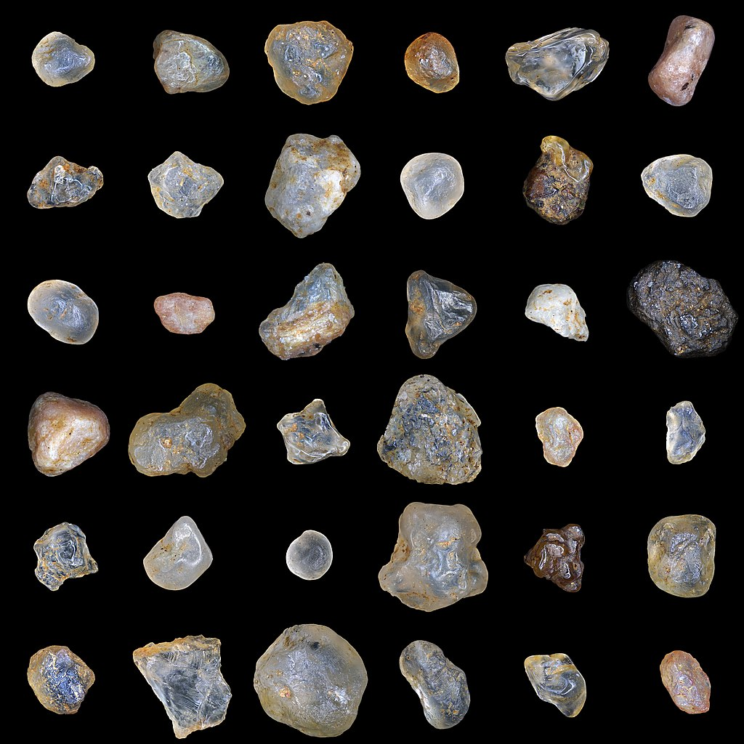
APP PHYSICS 157
FEATURE EXTRACTION USING IMAGEJ
SAMPLE FEATURE EXTRACTION
Basic blob detection and analysis of grains of sands
In this activity, we will consider segmenting the image of sand grains of varying shapes and sizes and draw some properties of individual grains using ImageJ.
It must be noted at first that to make physical measurements from digital images, a scale must be set that that can be used as reference. In this image, the sand grain with assumed known length or diameter was used as reference for values. Since the exact definition of sand varies, a range of sand particle diameter was taken – around 0.0625 mm as per the particle size set by geologists.
Figure 3. Sand grains of varying sizes. Image sourced from Wikipedia.

Slide 5
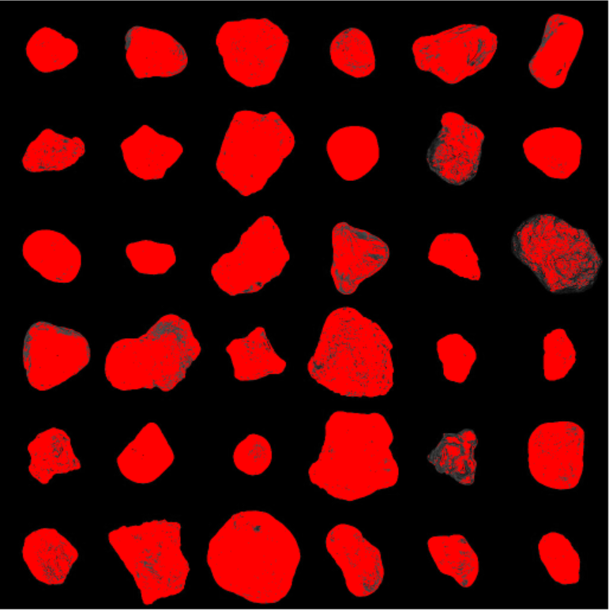
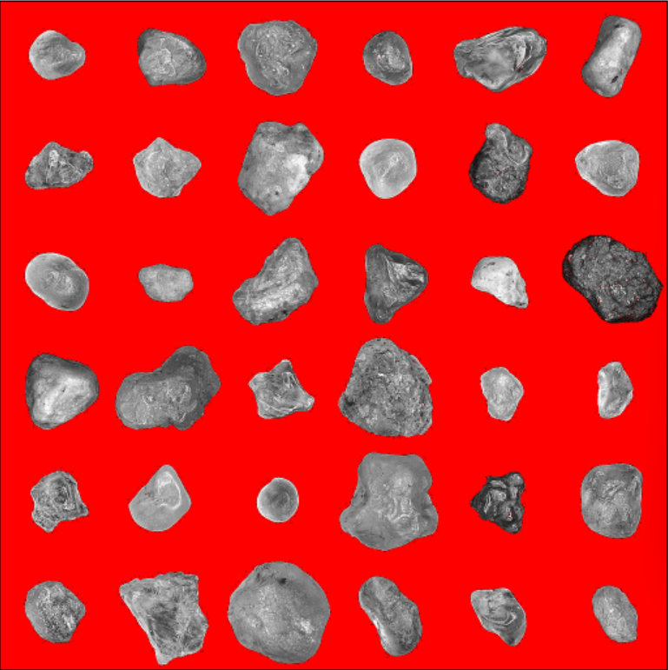

APP PHYSICS 157
FEATURE EXTRACTION USING IMAGEJ
SEGMENTATION BY THRESHOLDING
(a) Prior to threshold adjustment
(b) Adjusted threshold near peak values
(c) Threshold applied to sand image
Figure 4. Image segmentation by thresholding using ImageJ.
Prior to thresholding, the sand grains image was converted from RGB to 8-bit grayscale image. Converting the image to 8-bit is crucial so that we can segment our grains through thresholding. This can be seen in figures 4a and 4b where the grains are automatically segmented or separated from the background upon adjusting our threshold values. Basically, the grayscale makes the segmentation techniques much easier since a specific gray value will act as a cut-off, hence, threshold for our image!

Slide 6
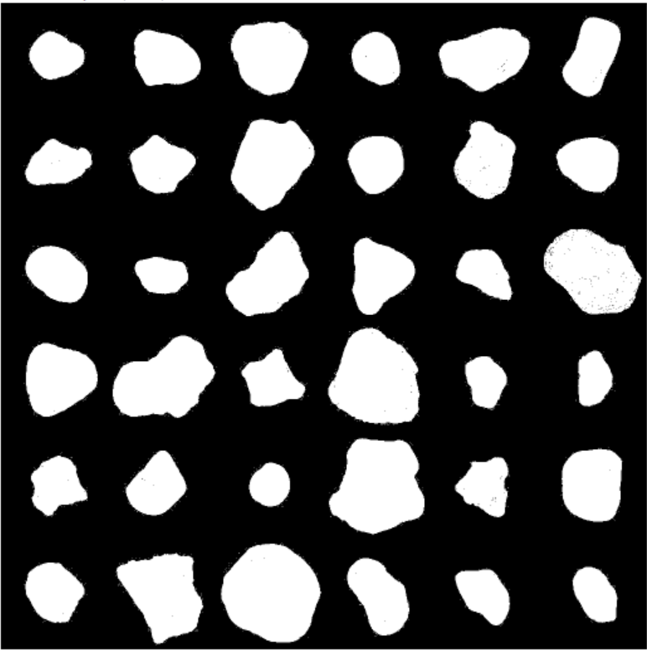
APP PHYSICS 157
FEATURE EXTRACTION USING IMAGEJ
BINARIZING THE IMAGE
After thresholding, we binarize the image. In principle, binarizing is the process of taking a grayscale image and converting it to black and white as it is. This reduces the information contained in the image since the 256 shades or values of gray has been reduced to two – black and white! This prepares ImageJ to measure some properties of the grains since the blobs or grains are now explicitly distinct from the background.
Figure 5. Binarized image of sand grains after thresholding.

Slide 7
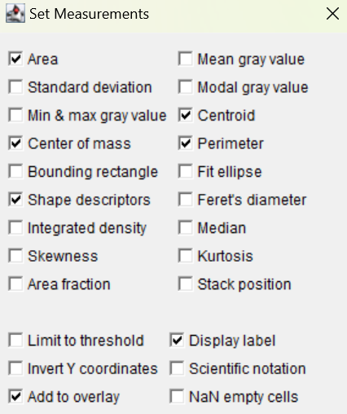
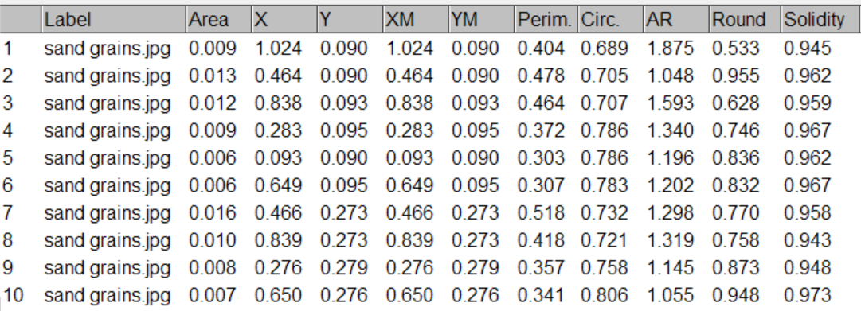
APP PHYSICS 157
FEATURE EXTRACTION USING IMAGEJ
SAND GRAIN MEASUREMENTS
Figure 7. Table of values for measurements generated.
From the set measurement options in ImageJ, the parameters of interest were chosen that will be extracted from the binarized image of our sand grains. This is why we have set a scale earlier since most of the measurements that will be returned were based on the set scaled diameter of the grain – 0.0625 mm as estimate or average.
Figure 6. Parameters to be measured from the grains.

Slide 8
APP PHYSICS 157
FEATURE EXTRACTION USING IMAGEJ
SAND GRAIN MEASUREMENTS
One of the interesting results observed is that ImageJ was able to quantify the number of sand grains in the image. This can be useful when one wants to count a somehow uncountable setup of objects on large scale – such as rice grains.
Other extracted features, from Figure 7, were the aspect ratio (AR), Roundness or inverse of aspect ratio, and solidity of grains, which is the ratio of the area and convex area.
Figure 8. Labelled blobs or sand grains after measurement in ImageJ.

Slide 9
APP PHYSICS 157
PROPERTIES AND APPLICATIONS OF THE 2D FFT
REFLECTION
I find the activity generally fun since it covers some of the real-world applications of Fourier Transform, which I really look forward to since it transcends beyond the what was taught in the lectures. I was also able to compare the differences of my results to what the theory suggests, specially on the activity on the convolution theorem redux since I was able to revisit some concepts I have picked up on the previous activities in the class. Overall, I would give myself a score of 110/100. Yay.
REFERENCES | GITHUB
M. Soriano, Applied Physics 157 – Properties and application of the 2D Fourier transform, 2023.
White Balancing — An Enhancement Technique in Image Processing

